Slide 1
Entity Framework
http://www.entityframeworktutorial.net

Slide 2
Topics
What is Entity Framework?
Basic Workflow in Entity Framework
How Entity Framework Works?
Entity States in Entity Framework
Development Approaches with Entity Framework
Entity Framework Core
EF Core vs EF 6
Assignment

Slide 3
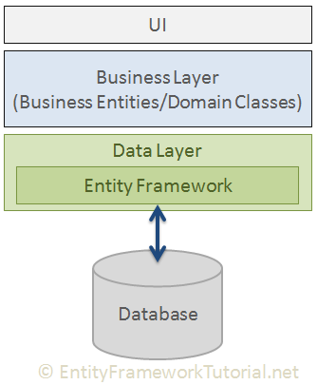
What is Entity Framework?
Entity Framework is an open-source ORM framework for .NET applications supported by Microsoft.
Object Relational Mapping (ORM) is a technique of accessing a relational database from an object-oriented language.

Slide 4
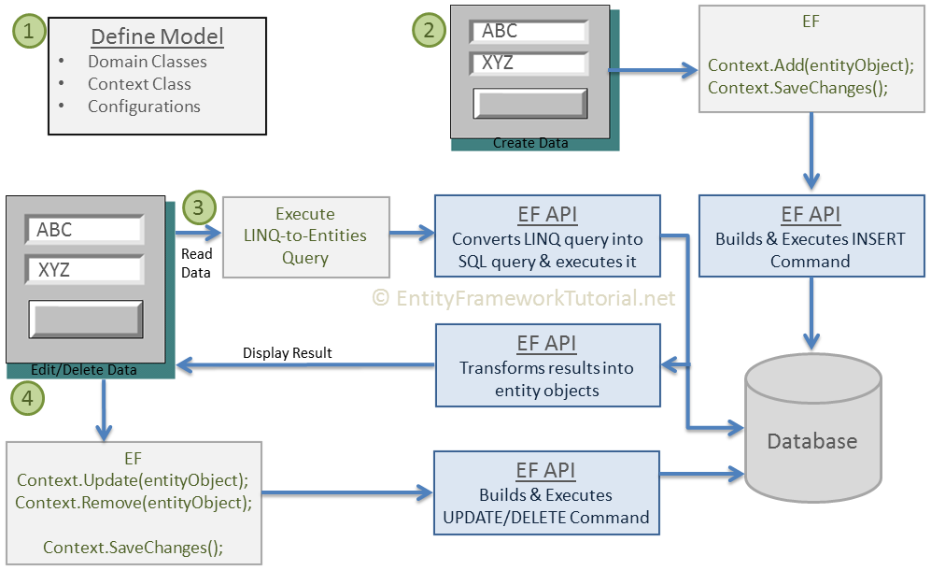
Basic Workflow in Entity Framework

Slide 5
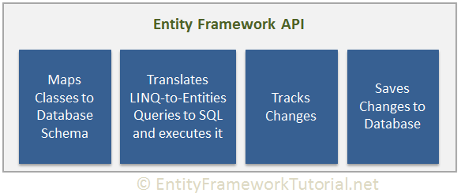
How Entity Framework Works?

Slide 6
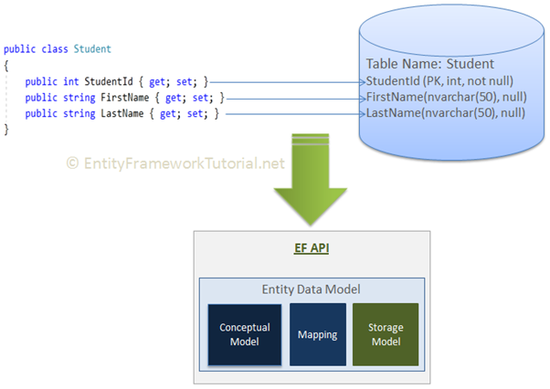
How Entity Framework Works?

Slide 7
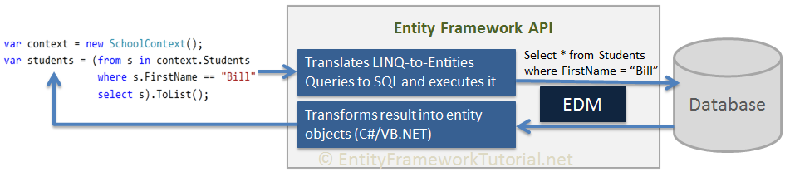
How Entity Framework Works?

Slide 8
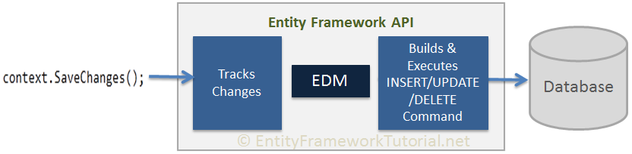
How Entity Framework Works?

Slide 9
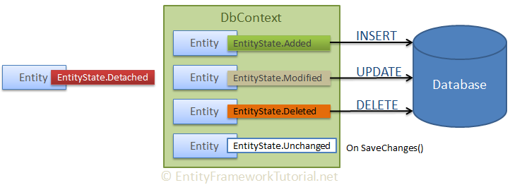
Entity States in Entity Framework
Added
Modified
Deleted
Unchanged
Detached

Slide 10
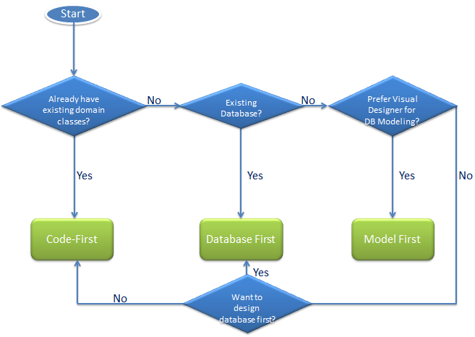
Development Approaches with Entity Framework
Database-First
Code-First
Model-First

Slide 11
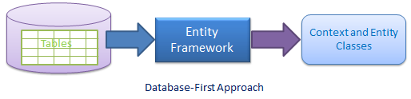
Development Approaches WITH Database-First

Slide 12
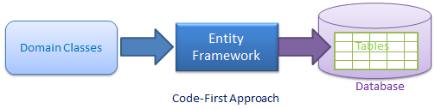
Development Approaches with Code-First

Slide 13
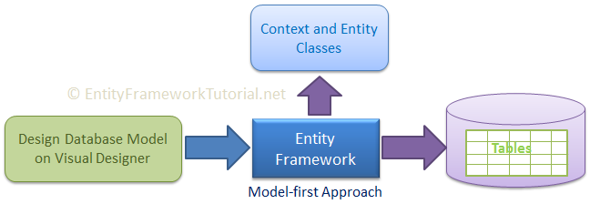
Development Approaches with Model-First

Slide 14
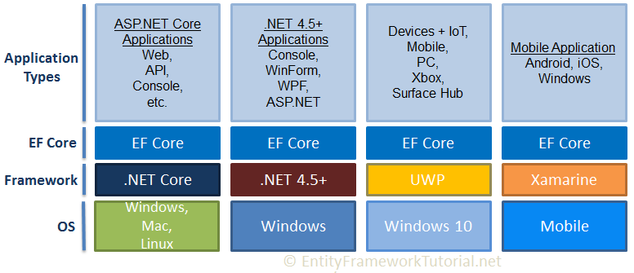
Entity Framework Core
Entity Framework Core is the new version of Entity Framework after EF 6.x. It is open-source, lightweight, extensible and a cross-platform version of Entity Framework data access technology.

Slide 15
Entity Framework Core
EF Core supports two development approaches 1) Code-First 2) Database-First. EF Core mainly targets the code-first approach and provides little support for the database-first approach because the visual designer or wizard for DB model is not supported as of EF Core 2.0.

Slide 16
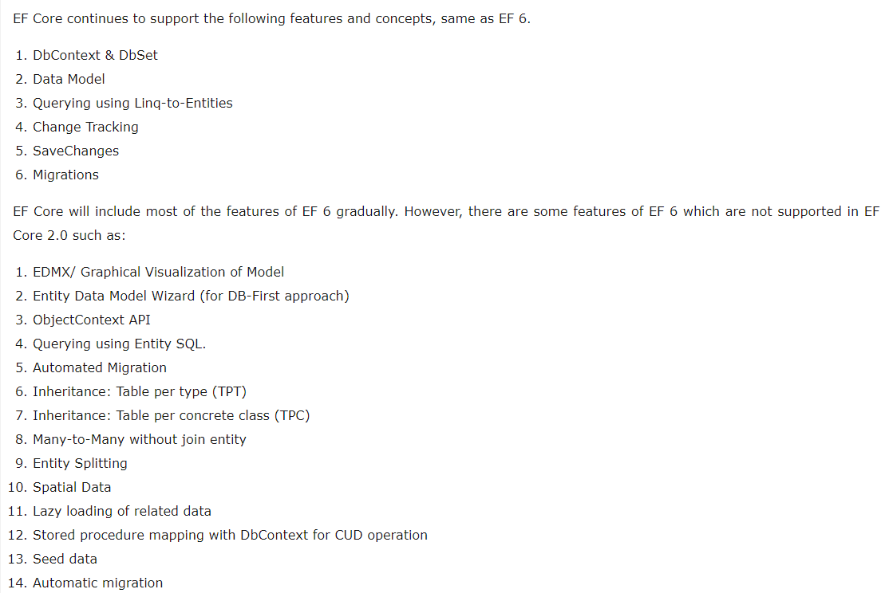
EF Core vs EF 6

Slide 17
EF Core vs EF 6

Slide 18
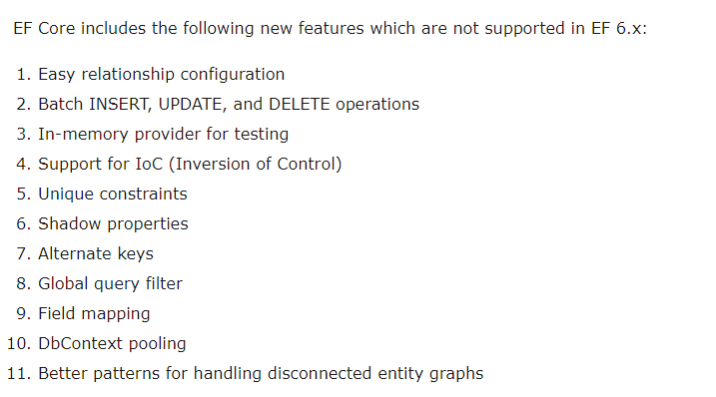
EF Core vs EF 6
https://docs.microsoft.com/en-us/ef/efcore-and-ef6/features

Slide 19
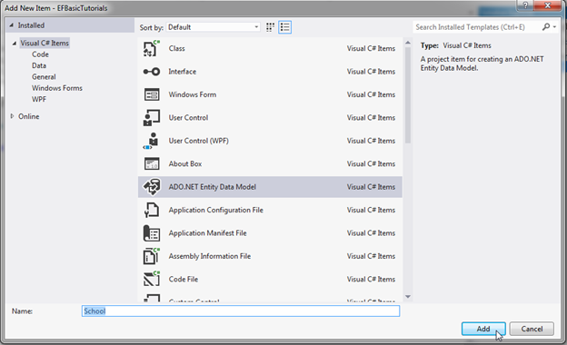
EF6
add Entity Data Model by right clicking on the project in the solution explorer -> Add -> New Item. This will open the Add New Item popup. In the popup, select ADO.NET Entity Data Model

Slide 20
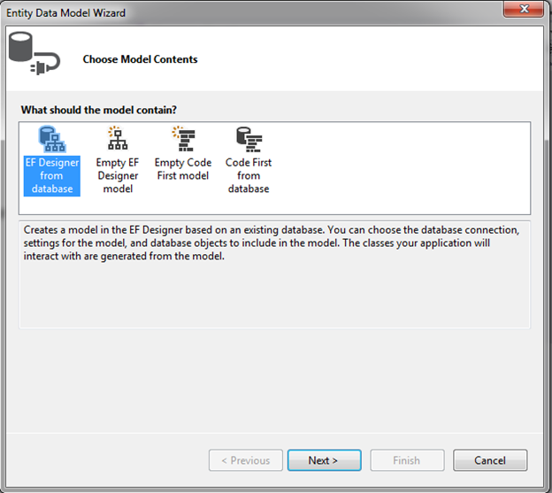
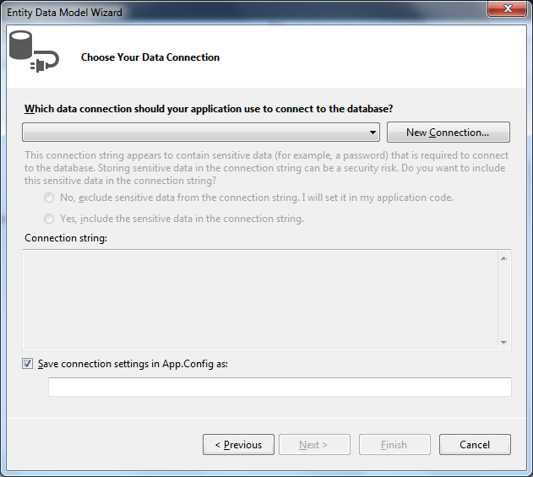
EF6

Slide 21
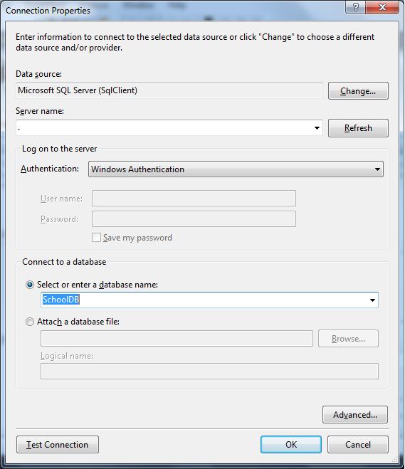
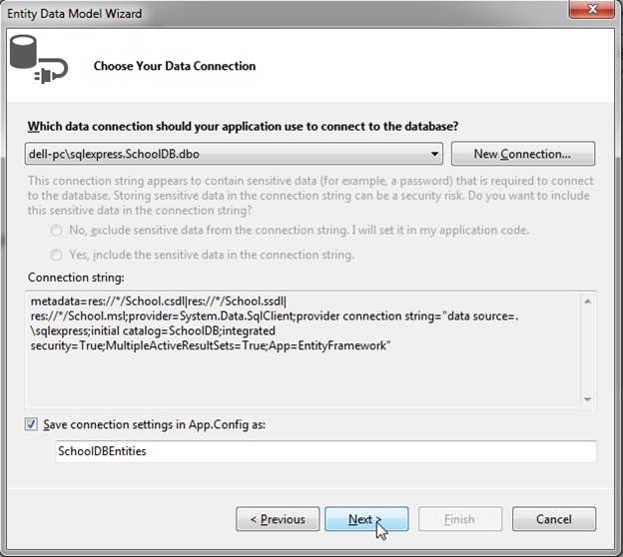
EF6

Slide 22
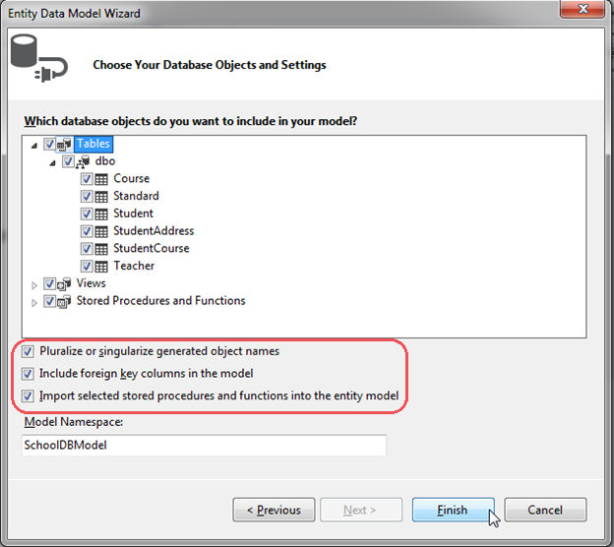
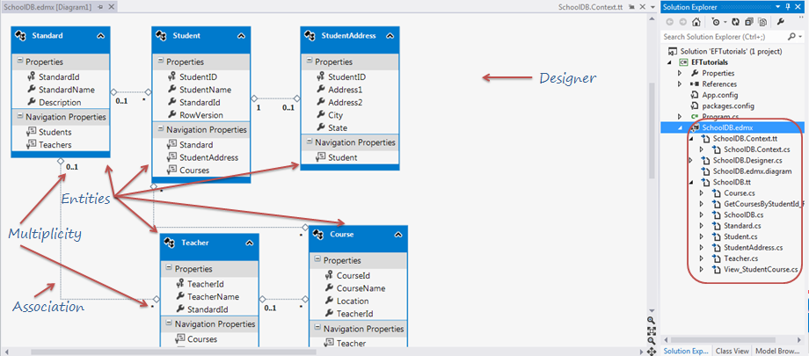
EF6

Slide 23
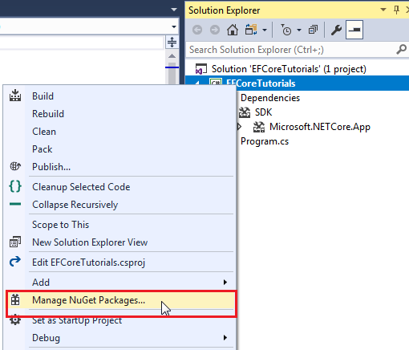
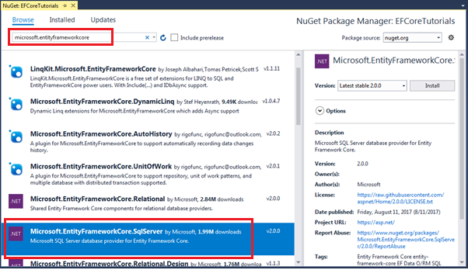
EF Core
You need to install NuGet packages for the following two things to use EF Core in your application:
1. EF Core DB provider
2. EF Core tools

Slide 24
EF Core
1. EF Core DB provider
Database | NuGet Package
SQL Server | Microsoft.EntityFrameworkCore.SqlServer
MySQL | MySql.Data.EntityFrameworkCore
PostgreSQL | Npgsql.EntityFrameworkCore.PostgreSQL
SQLite | Microsoft.EntityFrameworkCore.SQLite
SQL Compact | EntityFrameworkCore.SqlServerCompact40
In-memory | Microsoft.EntityFrameworkCore.InMemory
2. EF Core tools
Microsoft.EntityFrameworkCore.Tools
Microsoft.EntityFrameworkCore.Tools.DotNet

Slide 25
EF Core
Creating a Model for an Existing Database in Entity Framework Core
In Visual Studio, select menu Tools -> NuGet Package Manger -> Package Manger Console
Scaffold-DbContext [-Connection] [-Provider] [-OutputDir] [-Context] [-Schemas>] [-Tables>]
[-DataAnnotations] [-Force] [-Project] [-StartupProject] [<CommonParameters>]
Example
Scaffold-DbContext "Server=.\SQLExpress;Database=SchoolDB;Trusted_Connection=True;" Microsoft.EntityFrameworkCore.SqlServer -OutputDir Models

Slide 26
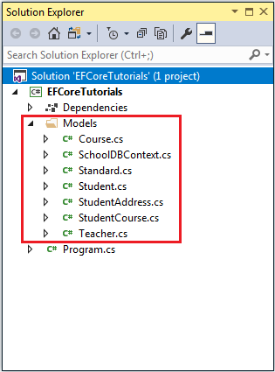
EF Core

Slide 27
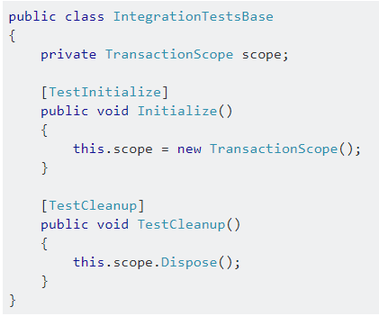
Unit Test
1- Install the EntityFramework into the Test Project.
2- Put the connection string into the app.config file of Test Project.
3- Reference the dll System.Transactions in Test Project.

Slide 28
Assignment
Create Console Application With EntityFramework
Create CRUD Service ( Add, Select, Update, Delete )
Create Unit test

